Slide 1

DBMS PROJECT
Team members:
Jhaanvi Golani
Shaheen Nazar
Pallavi Saboo
Komal Srivastava
Kalyani Ravi

Slide 2
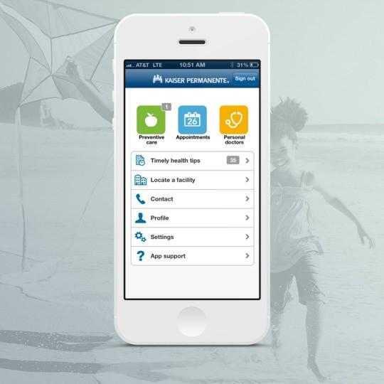
Agenda
Business Scenario
Swim Lane Diagram
ER Diagram
SQL Queries
Advanced SQL Queries
Visualization
Conclusion

Slide 3
Business Scenario
Ramie got an admit from SCU and is required to upload immunization records. Her healthcare provider is Kaiser. She wants to consult a doctor and get all the immunization requirements fulfilled. So, she books a telephone consultation appointment for 5:30 PM via the Kaiser app. The system updates the doctor's calendar and blocks the 5:30 PM slot for Ramie's consultation. The doctor calls Ramie at the scheduled time. Ramie explains the immunization requirements. The doctor ordered five lab tests on the Kaiser portal based on the patient's medical history. After this call, Ramie gets another call from Kaiser to schedule lab tests. The caller asks for a preferred location and time slot. Ramie scheduled the appointment for the next day at 10:30 AM.
The next day at the lab reception, Ramie shows her confirmation details on the app. Ramie gets a token number. The receptionist asks Ramie to wait until an automated system announces her token number. Soon, the automated system announces Ramie's token number and asks her to go to lab station 5. After reaching the lab station, Ramie shows her Kaiser ID to the lab official. The lab official confirms the appointment details in the system and conducts lab test.
After two days, Ramie receives an email stating that her reports are ready along with the payment link. She makes the payment and receives her lab test results on the registered email ID. The lab results are also recorded under 'Medical Record' in the Kaiser database.

Slide 4
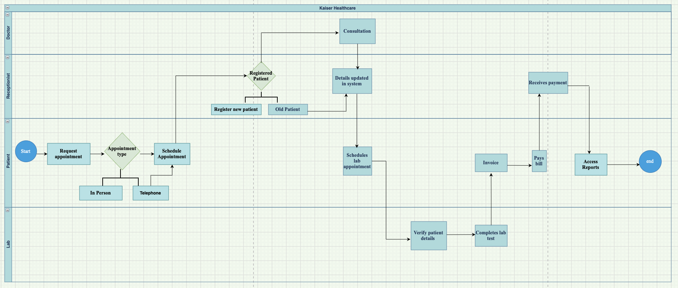
Swim Lane Diagram

Slide 5
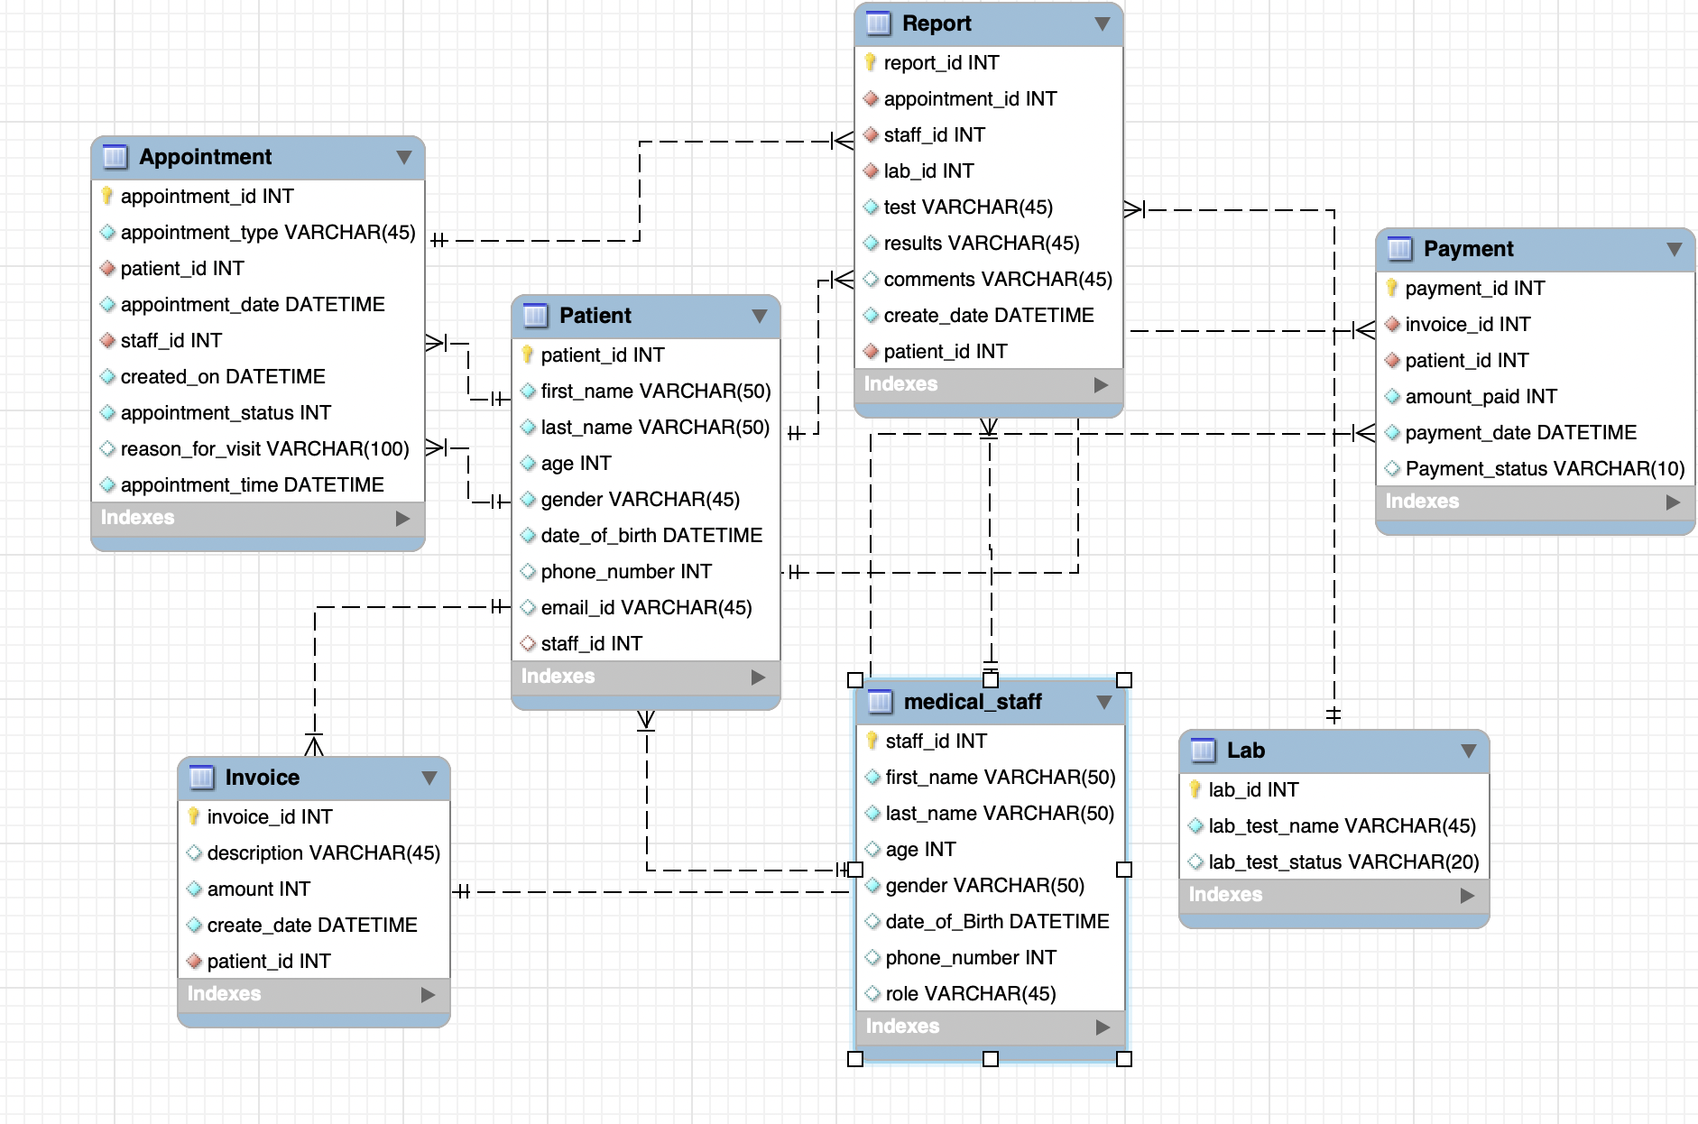
ER Diagram

Slide 6
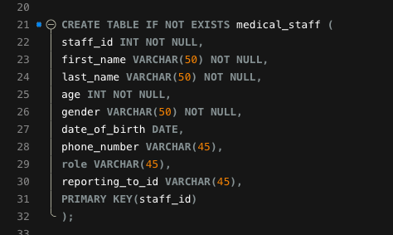
Table creation

Slide 7
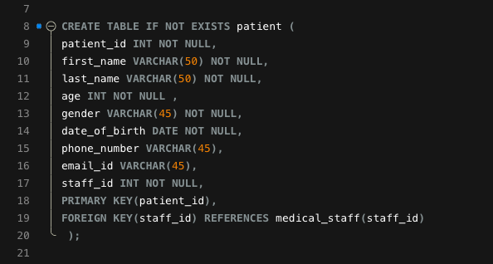
Table creation

Slide 8
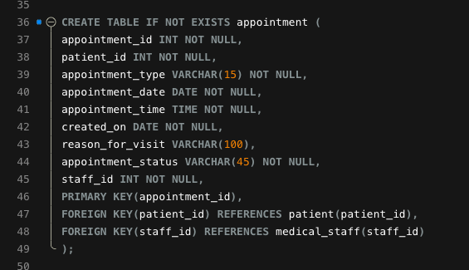
Table creation

Slide 9
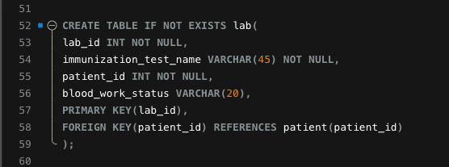
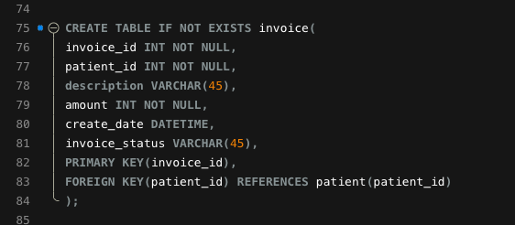
Table creation

Slide 10
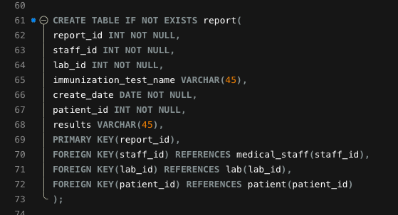
Table creation

Slide 11
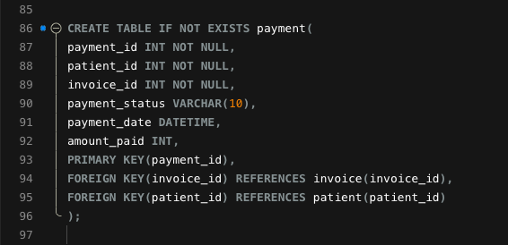
Table creation

Slide 12
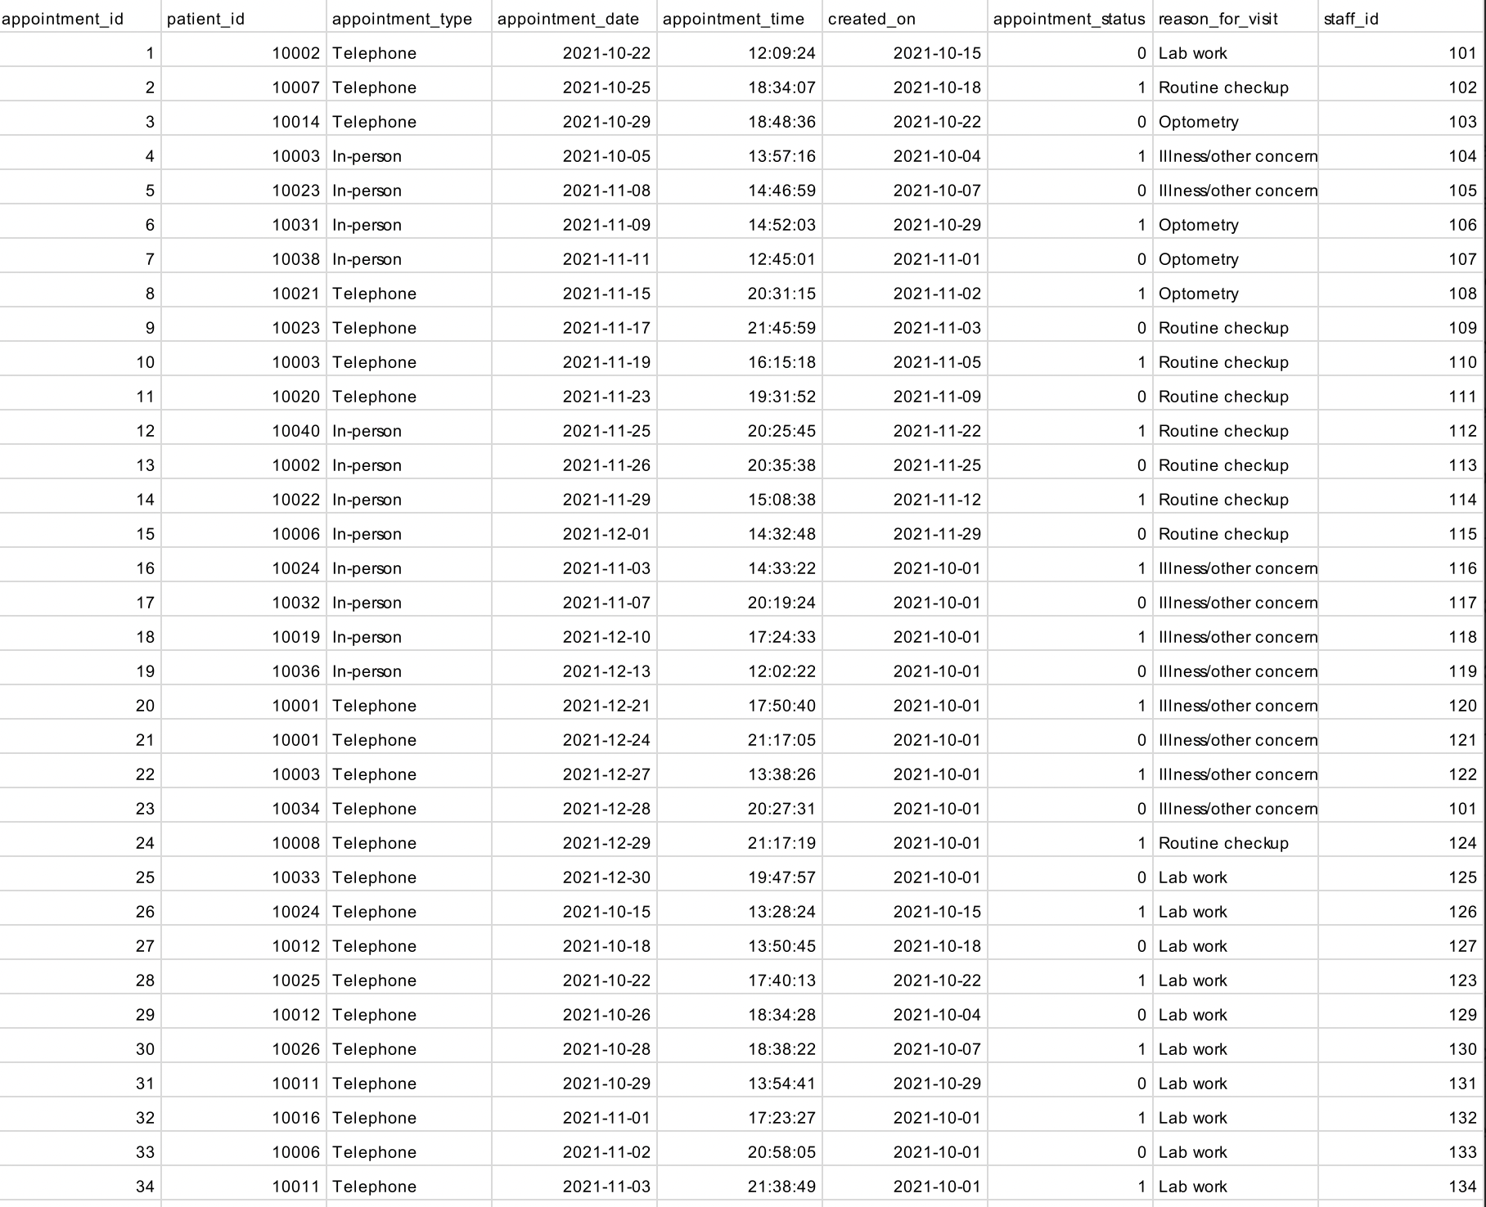
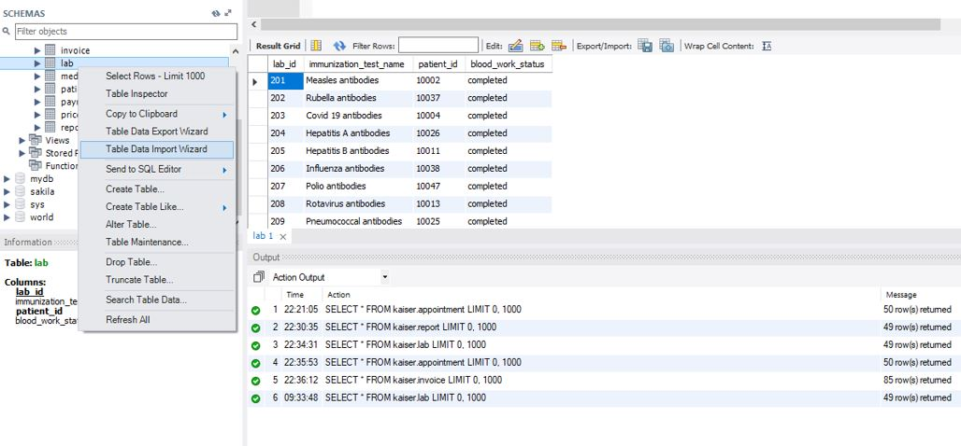
Importing data : CSV File

Slide 13
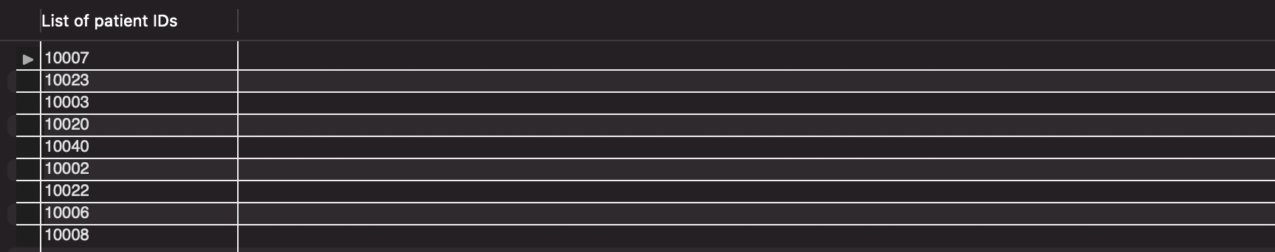
Without Joins:

Slide 14
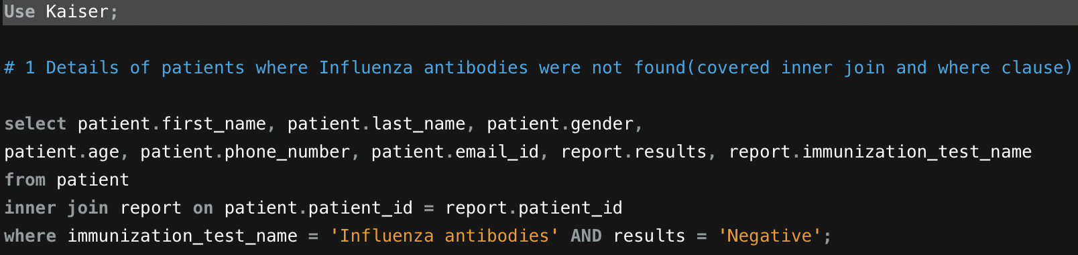
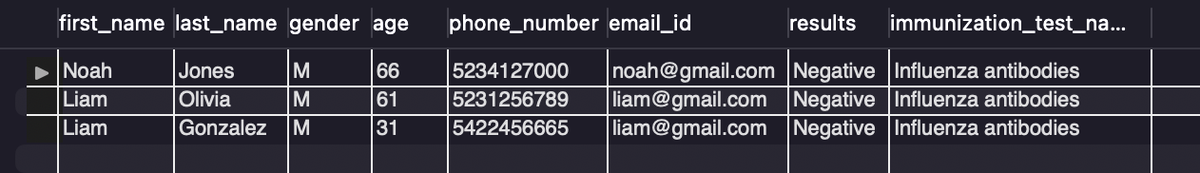
With joins:

Slide 15
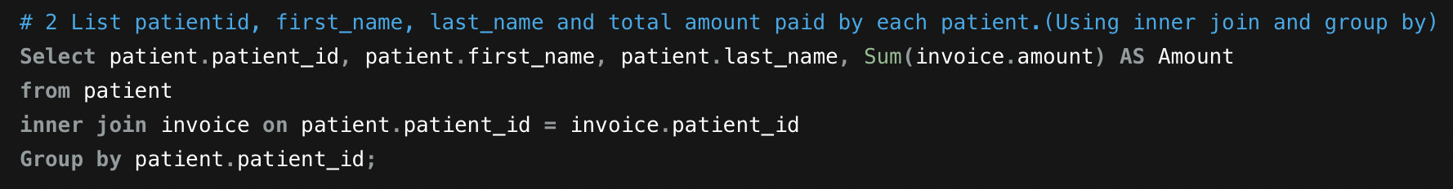
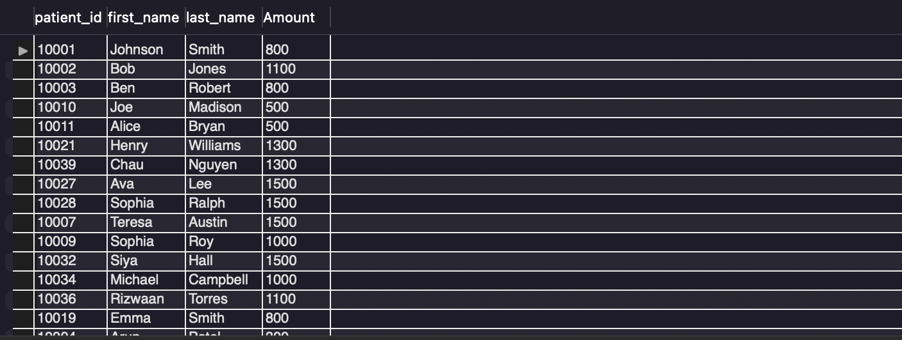

Slide 16
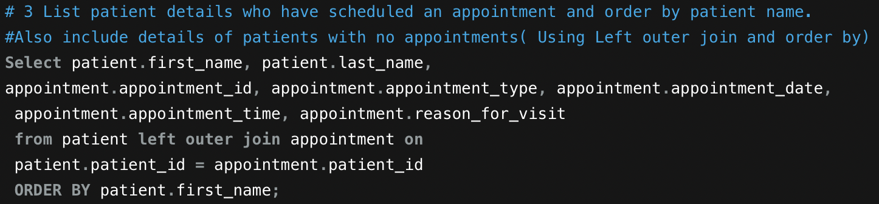
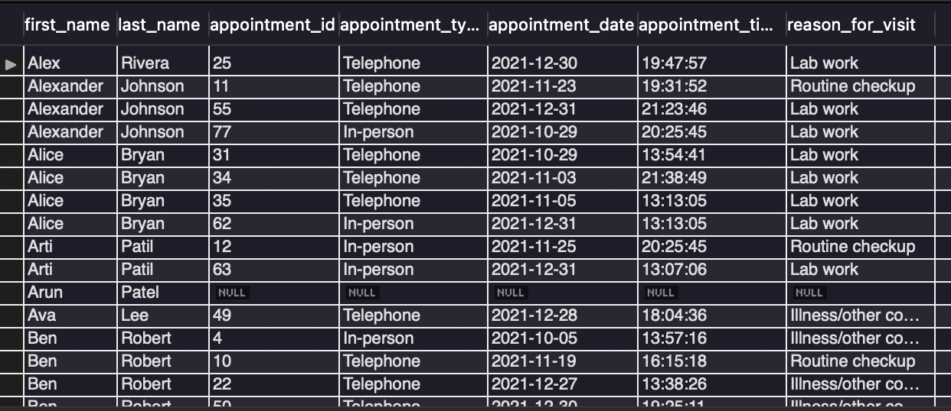

Slide 17
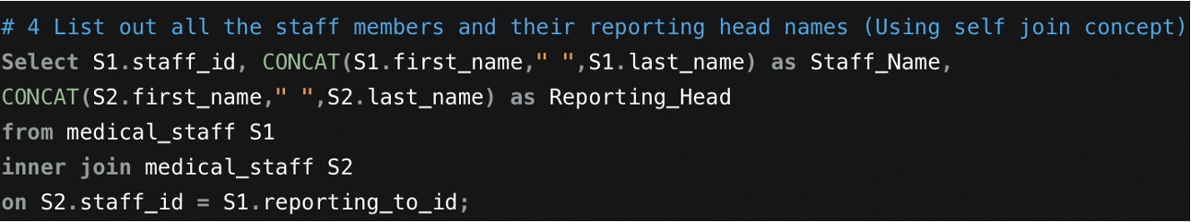
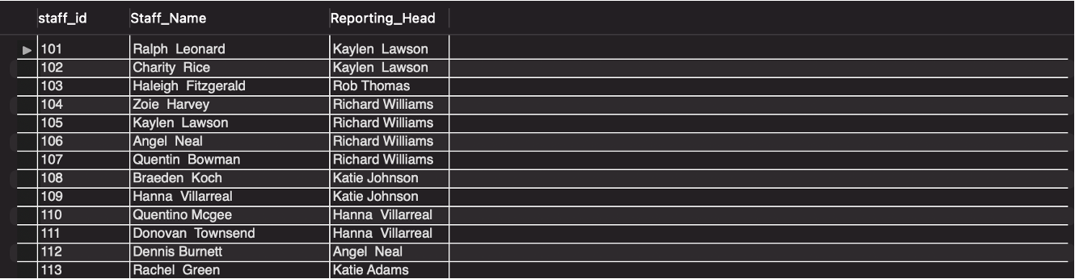

Slide 18
Advanced SQL concept application

Slide 19
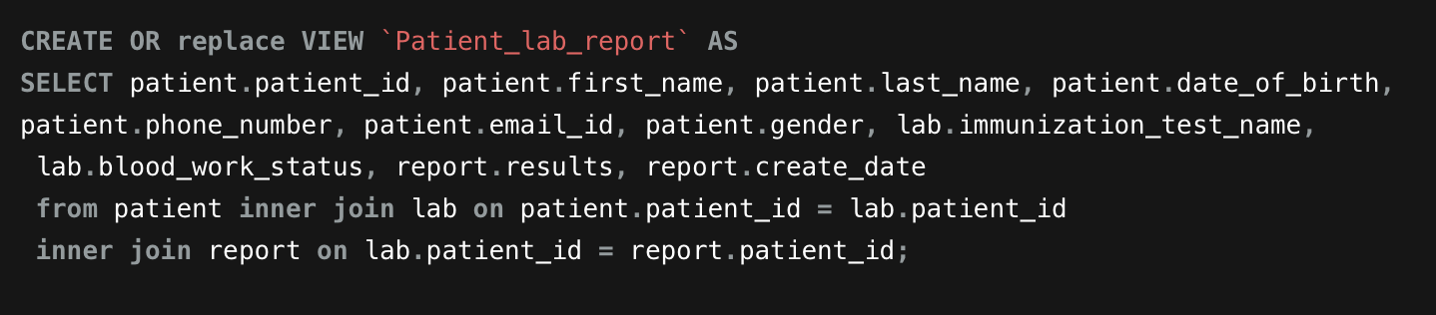
View creation

Slide 20
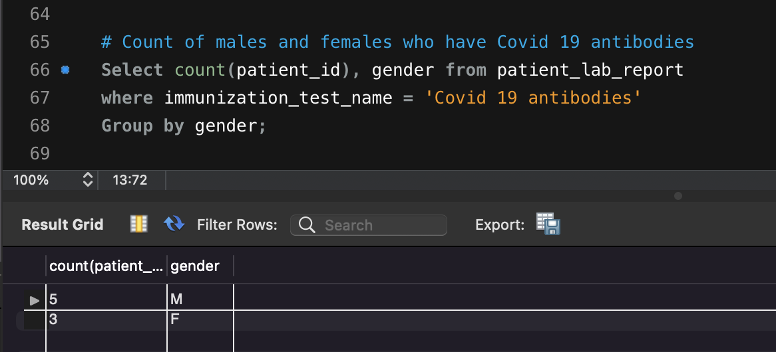
Query using view

Slide 21
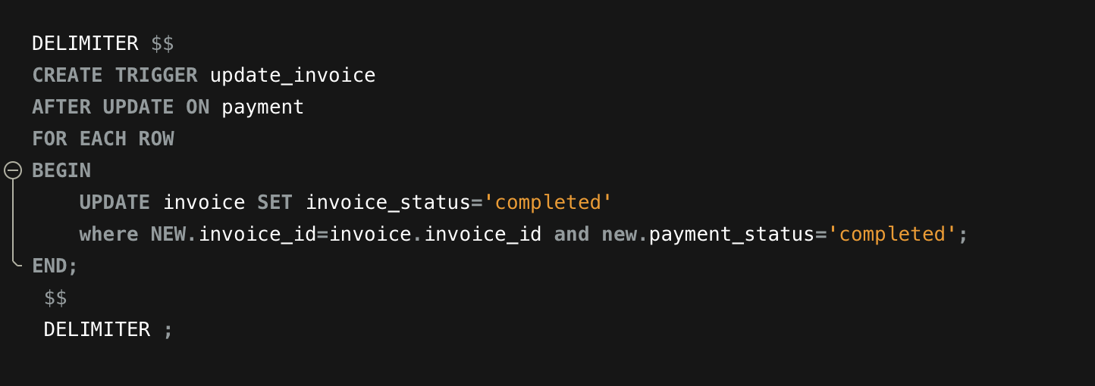
Trigger creation

Slide 22
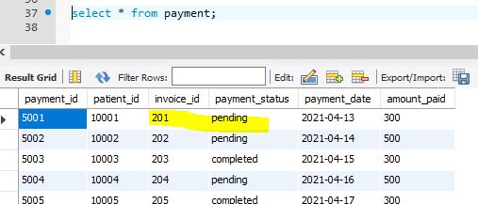
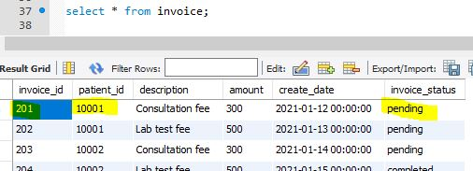
Fetching information from invoice & payment table before update

Slide 23
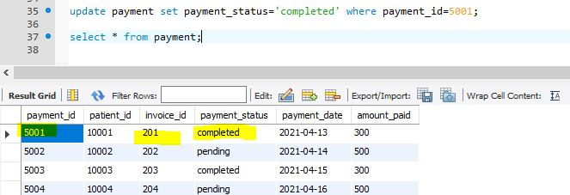
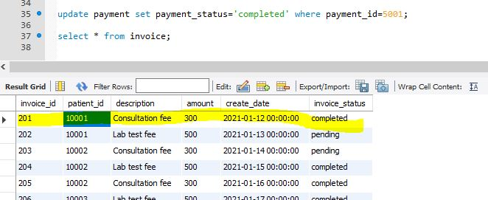
Trigger is triggered

Slide 24
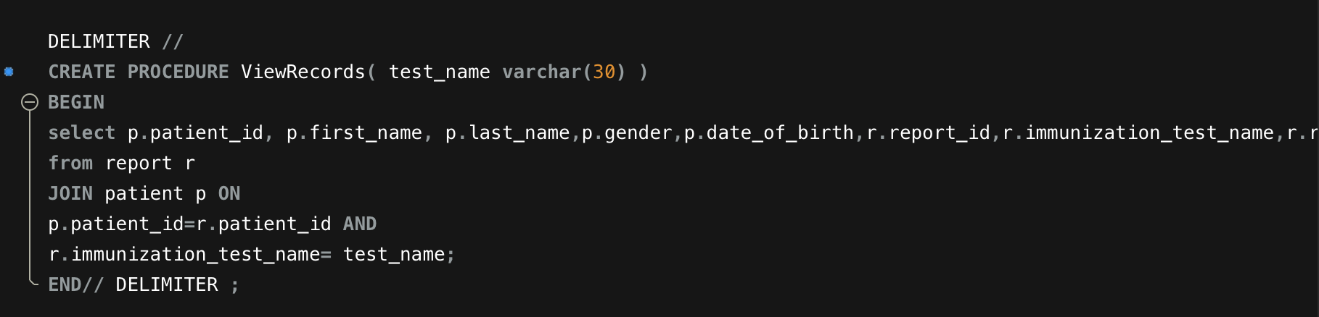
Procedure creation

Slide 25
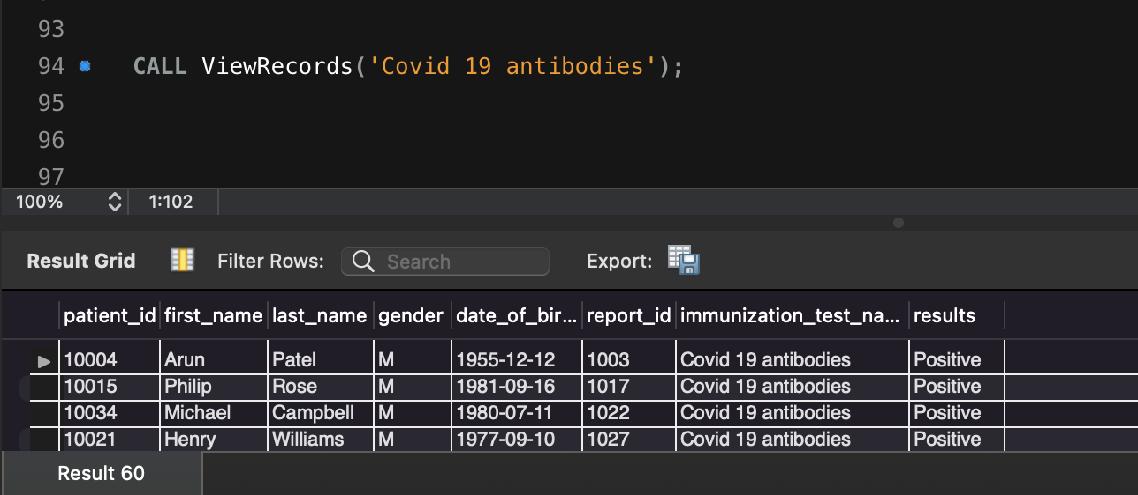
Calling procedure

Slide 26
Visualizations

Slide 27
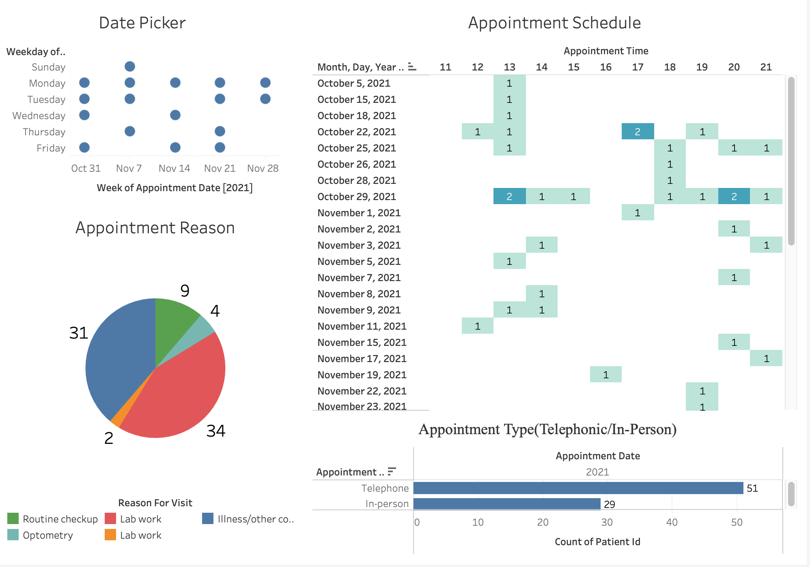
Tableau Dashboard

Slide 28
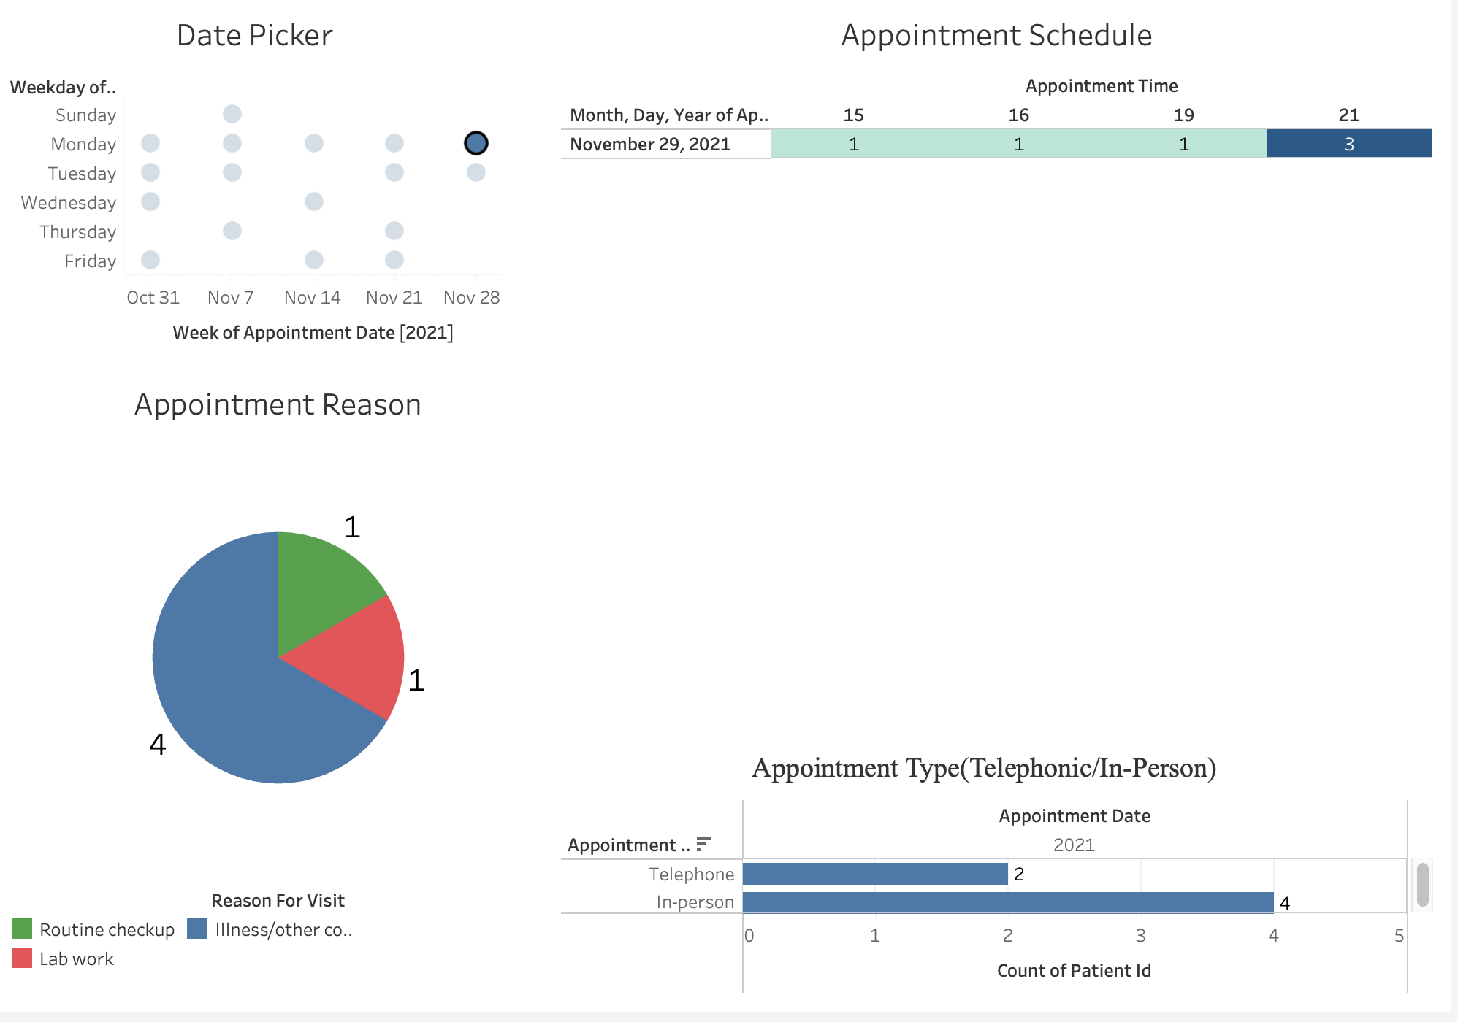
Tableau Dashboard - (Date Filter)

Slide 29
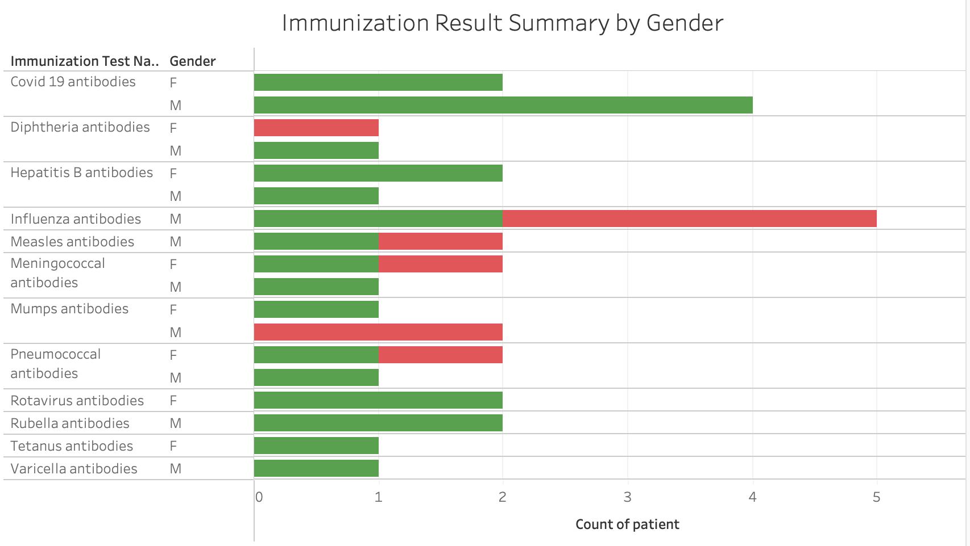

POSITIVE
NEGATIVE

Slide 30
Conclusion
This project helped us to apply the theoretical knowledge of DBMS in a real world scenario.
We learned and applied following concepts of SQL in our project:
Swimlane Diagram, ER Diagram, Table Creation, SQL Joins, Views, Triggers, Procedures.
If we were to work on this project again or extend this further:
Work on real world and large dataset
Extend our schema to include data related to location(address), departments, insurance provider, medical history.

Slide 31
THANK YOU

